Slide 1
Ratepayer Impact Study Stakeholder Meeting
May 23, 2022

Slide 2
Meeting Moderator:
Dianne Crilly
Office of the Economist
New Jersey Board of Public Utilities
05/23/2022 www.nj.gov/bpu

Slide 3
Stakeholder Process
The focus of this stakeholder meeting is to present
information regarding progress on
modeling and analysis for a
Ratepayer Impact Study of
clean energy policies presented in the most
recent Energy Master Plan
05/23/2022 www.nj.gov/bpu

Slide 4
Stakeholder Process
Please feel free to ask clarifying questions in the Q&A box during the presentation by The Brattle Group.
There will be an opportunity to present general comments after the presentation and during a public comment period through June 3, 2022.
A recording of this presentation and the slides will be made available at https://www.bpu.state.nj.us/bpu/newsroom/public/.
05/23/2022 www.nj.gov/bpu

Slide 5
Opening Remarks:
Abe Silverman
General Counsel
New Jersey Board of Public Utilities
05/23/2022 www.nj.gov/bpu

Slide 6
New Jersey Energy Master Plan – Ratepayer Impact Study
Stakeholder Meeting II
Prepared By
Sanem Sergici Goksin Kavlak
Kathleen Spees
Rohan Janakiraman
Prepared For
New Jersey Board of
Public Utilities
MAY 23, 2022

Slide 7
Agenda
1- Meeting Objectives
2- Comments Received after the 1st Stakeholder Meeting
3- Preliminary Observations
4- Discussion

Slide 8
Stakeholder Meeting Objective
EMP Ratepayer Impact Study is aimed at understanding the impact of the EMP on customers’ energy costs through a comprehensive analysis of rate impacts and overall energy costs as of 2030
Our objective with this meeting is to:
Summarize and respond to the comments submitted after the 1st Stakeholder meeting held March 25, 2022.
Identify areas in which Study is being modified as a result of these comments.
Discuss high-level preliminary study results for representative residential customers of one gas/electric utility combination.

Slide 9
Roughly 30 organizations submitted more than 150 comments
Our team reviewed the comments and grouped them into 10 different themes.
In this presentation, we will go through each of these themes, summarize the comments, and offer a response.
In some cases, these comments prompted revisions to our study assumptions, which we will note in our discussion.

Slide 10
Theme 1: Limited study scope
Synopsis: Multiple commenters found the Study scope limited and asked to expand it to include the climate impact mitigation and public health-related benefits of the EMP.
Some of these cited benefits are avoiding health impacts caused by fossil-fuel-generated air pollution, water pollution, and the increasing direct effects of climate change, like stronger and more frequent storms and flooding.
Response: Brattle and the Board acknowledge and agree that the EMP will play a major role reducing emissions and adverse effects of climate change. However, quantifying these costs is outside the scope of this particular Study.
NJBPU commissioned this Study to evaluate the impacts of the EMP on the ratepayers and total energy burden when EMP programs are implemented, taking into account both direct costs and benefits.
It is an ambitious effort to carefully analyze all the costs and benefits of the EMP for eight electric-gas utility combinations and for three customer classes.
Actions: The Study will acknowledge and discuss environmental and public health benefits on a qualitative basis. Additionally, in order to provide a sense for the avoided damages from the reduced emissions, the Study team will calculate the avoided cost of emissions using “Social Cost of Carbon.” Board Staff likewise acknowledges the potential usefulness of conducting a rigorous study in the future of climate and health benefits.

Slide 11
Theme 2: Understated grid infrastructure costs
Synopsis: Multiple commenters indicated that the Study might be understating the grid infrastructure costs on the delivery system that would be necessary to meet the EMP targets. More specifically, parties asked to provide additional insight into the assumed 1% real growth year-over-year (YoY) revenue requirement on the basis that a 1% growth assumption likely underestimates the level of necessary investment given the more ambitious pathways being assessed in the Study.
Response: The best approach to inform this assumption is to rely on utility “distribution system plans” for the next decade for the estimated costs of integrating the new load and generation associated with meeting EMP targets. In the absence of formal Integrated Distribution Plan requirements from the Board, we reviewed utilities’ historical revenue requirements and found that they have increased in the range of 1-2% YoY over the past 5 years.
Based on these data, we have originally assumed 1% YoY growth rate through 2030 for all three scenarios on the basis that the system already has some headroom for growth and the use of load flexibility programs to keep the growth rate under check.
Action: The Study team decided to revise this assumption for the “EMP Achievement” and “Ambitious” scenarios, and now assume 2% year-over-year growth rate through 2030 for electric utilities.

Slide 12
Theme 3: Fixed monthly customer charge growth is overstated
Synopsis: Several commenters noted that the assumption of 20% increase in utilities' fixed monthly customer charges from 2020 levels by the Study year 2030 may overstate historic trends and may result in underestimating the volumetric rates.
Response: We assume 20% nominal growth rate which implies keeping the fixed monthly customer charge constant in real dollars.
In developing this assumption, we reviewed the changes in customer charges for the NJ electric and gas utilities over the past 10 years.
We found that the customer charges increased by 1-6% YoY in nominal terms.
Action: We are not revising this assumption at this time (even though there is basis for increasing it and leading to lower volumetric rates). However, we have taken the conservative approach of keeping fixed monthly charges as initially proposed; this ensures our results remain conservative and do not understate rate impacts.

Slide 13
Theme 4: Study does not utilize more efficient rate designs that might be adopted in the future
Synopsis: Several commenters indicated that the Study cost impacts will be overstated due to the assumption that utilities’ rate designs will not change before 2030.
Response: The Study team agrees that there could be significant savings associated with future rate design changes and that time varying rates (TVR) can be an effective tool to mitigate costly grid infrastructure expansion if/when they achieve higher levels of participation. However, these rates are not currently implemented, and the Study team recommends making the conservative assumption to not include the potential benefits of TVRs in the Study at this time. Once utilities put forward more concrete plans on their rate design proposals, these assumptions can be integrated into the next ratepayer impact study.
Action: The Study will continue to make the status quo rate design assumption but will discuss options to help contain grid infrastructure costs such as TVRs and active managed charging programs in the conclusions section. Further, Board Staff sees value in conducting a further study to determine how best to implement TVRs, particularly once New Jersey reaches critical deploying of smart meters in the next few years. Based on experience in other jurisdictions, it takes a few of years for utilities to design, test, implement and market TVRs. While it takes several years to achieve significant participation (~15%) under opt-in programs, implementation can be sped up by making TVRs the default rate structure.

Slide 14
Theme 5: Study should account for fuel oil/propane switching
Synopsis: Several commenters recommended to include a consumer profile for either a fuel oil or propane customer to highlight the cost savings for this consumer group that may be associated with building electrification.
Response: Based on our analysis of the U.S Energy Information Administration (EIA) data, 9.6% of residential homes use fuel oil or propane for heating in New Jersey. Even though fuel oil/propane represents a small share of heating demand, we agree that it should be included and will include this customer type in our “cost impact analysis.”
Actions:
We create a one-off sensitivity for a residential customer heating with fuel oil/propane switching to electric heating as a direct response to this comment.

Slide 15
Theme 6: Study relies on obsolete 2019 EMP study assumptions
Synopsis: Several commenters suggested that the Study should utilize the latest cost assumptions that take into account current market conditions, rather than relying on the cost assumptions that supported development of the 2019 EMP "Least Cost Pathway."
Response: The Ratepayer Impact Study relies on the 2019 EMP study only for the quantities of clean energy programs, implied by the “Least Cost Pathway” in the EMP. The Study relies on the most recent market data including the recent commodity prices from the EIA Annual Energy Outlook (2021).
Action: No change.

Slide 16
Theme 7: Input on the presentation of the results
Synopsis: Several commenters offered input on the presentation of the Study results. Some examples include:
Add citations and comprehensive list of references.
Establish the baseline energy usage, cost and impact for each customer class including, at a minimum, multifamily and single-family residential customer and small and large non-residential customer.
Include information on both how much ratepayers are paying for clean energy now and what they would be paying in the future under each scenario.
Address affordability considerations.
Response: The final Study report will address most of the suggestions raised by the commenters as helpful ways of presenting the Study results. The current Study is already very detailed in how it evaluates the EMP impact for different utility combinations, rate classes, and different EMP programs.
Action: Study will incorporate presented ideas to the extent possible.

Slide 17
Theme 8: Input on assumptions and sensitivities
Synopsis: Numerous commenters proposed alternative assumptions and sensitivity cases on different dimensions of the Study. Several of these areas are listed below:
Multiple ways of defining low-income customers.
Definition of a low cost/environmentally ambitious scenario.
Customer adoption rates of new technologies.
Estimation of costs collectively instead of individually.
A reference case that models the policies prior to the implementation of EMP.
Response: While most of these inputs around assumptions and sensitivities are useful, they are either out of the scope for this Study (e.g., adoption rates of new technologies), or expand the boundaries of an already complex and ambitious Study.
Action: No direct changes to the Study design at this time.

Slide 18
Theme 9: Model clean fuel pathway as one of the study scenarios
Synopsis: Several commenters recommended that the Study should include a “clean fuel pathway” which leverages the existing gas infrastructure through blending clean molecules and compare this with full-electrification approach as reflected in the EMP “Least Cost Pathway.”
Response: Current Study scope involves the modeling of the ratepayer impacts of the programs and resources in the EMP “Least Cost Pathway.” A clean fuel pathway was examined as part of the EMP, and was not included in the Least Cost scenario until 2045, which is significantly outside the scope of the 2030 scenario considered by this Study. Further, exploring the viability of a clean fuel pathway is out of scope for the current Study.
Action: No changes to the Study design at this time.

Slide 19
Theme 10: Extension of the study time frame to 2050
Synopsis: Several commenters recommended to extend the Study time frame to 2050 to have a comprehensive view of the EMP costs and benefits by 2050.
Response: While it is true that the EMP program benefits and costs will accrue beyond 2030, estimating these costs and benefits become exceedingly difficult as the time horizon expands. We decided to focus on the next decade as we investigate the ratepayer impacts, acknowledging that this Study will need to be refreshed as more information becomes available in the future.
Action: No changes to the Study design at this time.

Slide 20
Preliminary Observations

Slide 21
Model Scenarios
The Study will include a comprehensive analysis of energy costs for residential and commercial and industrial (C&I) customers, for both electricity and natural gas service.
The Study will analyze expected ratepayer energy costs in 2030 under the following scenarios and compare them to costs in a recent year in 2022 dollars.
Scenario | Description
1. Current Policy Pathway | Includes the total costs and benefits of clean energy programs that are currently enshrined in New Jersey policies and consistent with current market trajectory
2. EMP Achievement Pathway | Developed from EMP “Least Cost Pathway" Includes total costs and benefits of clean energy programs that would be necessary to meet the EMP’s “Least Cost Pathway," which is designed to result in 100% clean energy by 2050
3. Ambitious Pathway | Evaluates relative energy costs associated with earlier achievement of 100% clean electricity in 2035 from 2050
In addition, the Study will include a sensitivity analysis to examine the change to emissions and total consumer energy costs that would be estimated under alternative Study assumptions, such as higher levels of electric vehicle adoption or building decarbonization efforts.

Slide 22
Key Scenario Assumptions - 2030
 | Current Policy Pathway | EMP Achievement Pathway | Ambitious Pathway
Energy Efficiency
Reduction in energy use | Cumulative: 9% electric and 5% gas use reduction compared to 2020. Annual average YoY: 1% for electric, 0.5% for gas | Cumulative: 12% electric and 7% gas use reduction compared to 2020. Annual average YoY: 1.3% for electric, 0.7% for gas | Cumulative: 12% electric and 7% gas use reduction compared to 2020. Annual average YoY: 1.3% for electric, 0.7% for gas
Transportation Electrification
Light duty EV share in 2030 | 30% of sales, 10% of stock (467K electric vehicles on the road) | 85% of sales, 29% of stock(*) (1.3M electric vehicles on the road) | 85% of sales, 29% of stock (*) (1.3M electric vehicles on the road)
Medium duty EV share in 2030 | 20% of sales, 4% of stock | 65% of sales, 13% of stock (*) | 65% of sales, 13% of stock (*)
Heavy duty EV share in 2030 | 13% of sales, 2% of stock | 43% of sales, 7% of stock (*) | 43% of sales, 7% of stock (*)
Building Decarbonization
Reduction in natural gas use for heating | Natural gas demand declines at 0.2% YoY rate from 2020 to 2030 | Natural gas demand declines at 2.4% YoY rate from 2020 to 2030 | Natural gas demand declines at 3% YoY rate from 2020 to 2030
Energy
RPS Class I renewables | 50% by 2030 | 50% by 2030 | 58% by 2030
Nuclear | ~3.5 GW | ~3.5 GW | ~3.5 GW
Solar | 12 GW (after 2026, continue adding same annual quantities under SuSI) | 12 GW (after 2026, generic PJM solar purchases rather than through SuSI) | 14.5 GW
Storage | 2 GW | 2.5 GW | 2.5 GW
Offshore wind | 3.7 GW | 3.7 GW + 1.2 GW (3rd solicitation) | 3.7 GW + 1.2 GW (3rd solicitation)
Note: Technology efficiencies and prices do not change across scenarios.

Slide 23
Residential Customer Total Energy Cost Impacts
In this section, we present some preliminary results for “Total Energy Cost Impacts” for the residential class
While we have developed similar results for eight electric-gas utility combinations serving NJ customers, we present the ACE-SJG results today. Other utility results are directionally similar.
We present results separately for low and moderate income (LMI) customers and non-LMI customers.
We present total energy cost impacts for 2020, Current Policy Pathway (2030) and EMP Achievement Pathway (2030) scenarios. Ambitious Pathway results are in development.
All results are expressed in 2022$ to be able to compare scenario results in real dollars.
Total energy cost impacts only reflect the operating costs of the electrification technologies. Customers will need to incur capital expenses to adopt these technologies, likely with assistance from state-sponsored incentives, and these costs are not factored into the cost impact calculations.

Slide 24
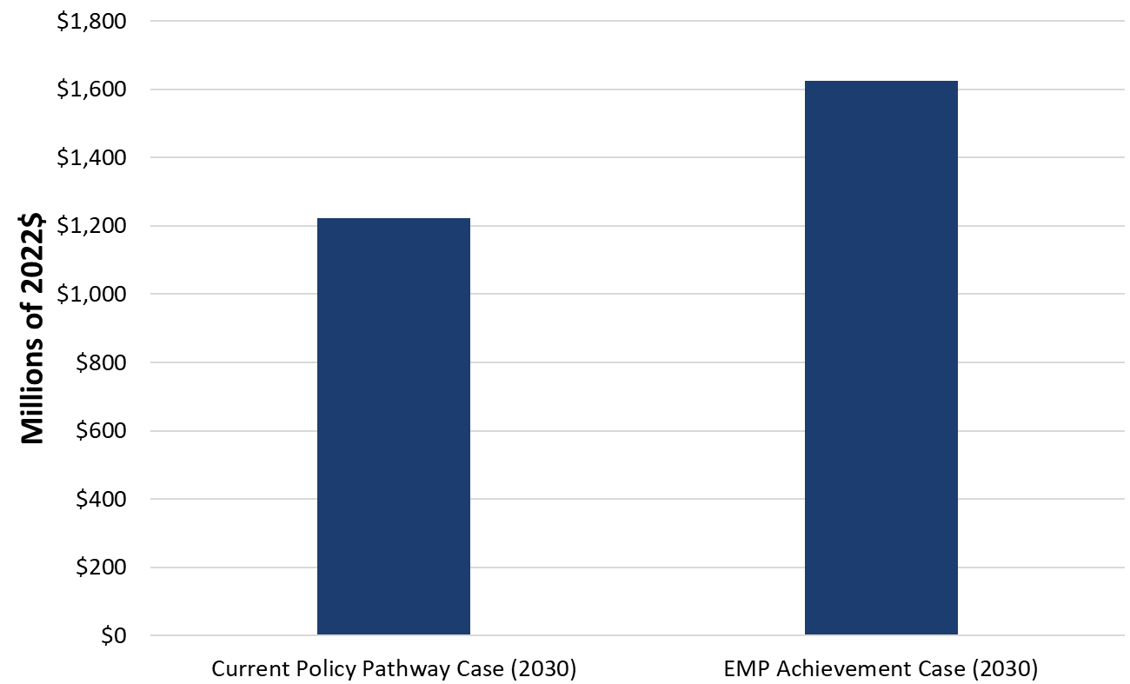
Takeaway 1: Avoided Cost of GHG Emissions in 2030 is substantial
EMP will lead to a plethora of other benefits ranging from climate impact mitigation to avoided health impacts. While we do not quantify these benefits in our study, we calculate the avoided cost of greenhouse gas emissions in 2030 using Social Cost of Carbon.
The annual benefit of reduced GHG emissions is $1.22 billion and $1.63 billion/year in 2030 in the Current Policy Pathway and EMP Achievement Pathway, respectively¹
Annual greenhouse gas emissions decrease by 20-30% from 2020 levels by 2030
This is only one component of broader benefits of EMP, which also include local air quality and health co-benefits, estimated to equal $3 billion/year in the EMP
Avoided Cost of GHG Emissions in 2030 (2022$)
25 million metric tons
19 million metric tons
This is equivalent to avoided emissions from 2.4-3.1 milion homes' energy use for one year, or 4-5.4 million gasoline vehicles driven for one year.
¹ Social cost of carbon is estimated at $64.50/ton (2022$) for 2030 based on Technical Support Document: Social Cost of Carbon, Methane, (whitehouse.gov)

Slide 25
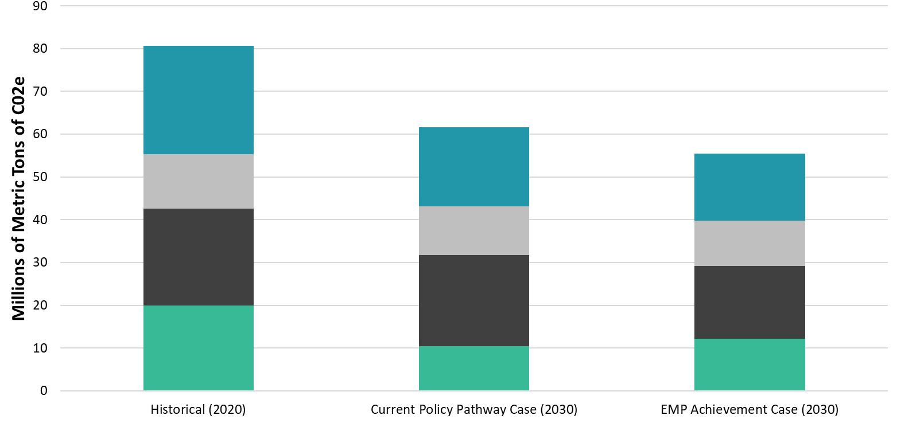
Annual Greenhouse Gas Emissions by Scenario (cont’d)
Gasoline
Fuel Oil and Propane
Natural Gas
Electricity

Slide 26
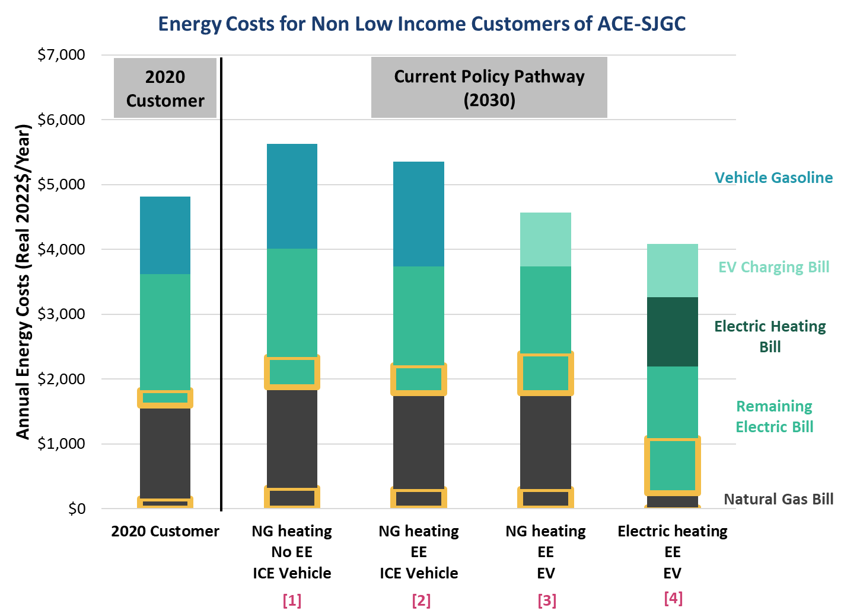
Takeaway 2: EE and Electrification offer significant customer savings under the Current Policy Pathway
[1] Keeping energy use constant at 2020 levels, annual energy cost increases by 17% relative to the [2020 Customer], in real dollars
[2] EE reduces annual energy cost by 5% compared to [1]
[3] EV adoption reduces energy costs by 15% compared to [2]
[4] Electrified space and water heating further reduces annual costs by 11% compared to [3]
We envision that most customers will fit profile [2] and increasing number of customers will fit in [3] and [4] by 2030
[2] total energy cost is 11% higher compared to the [2020 Customer]
[4] total energy cost is 15% lower compared to the [2020 Customer]
Electrification trends are consistent with national trends under this scenario. EV program costs are modeled consistent with utility EV program budgets.
Note: Annual energy costs are shown for non-low-income customers of ACE – SJG. Results have similar directionality for other utility combinations.
Yellow boxes represent the “clean energy program costs” within the bills.

Slide 27
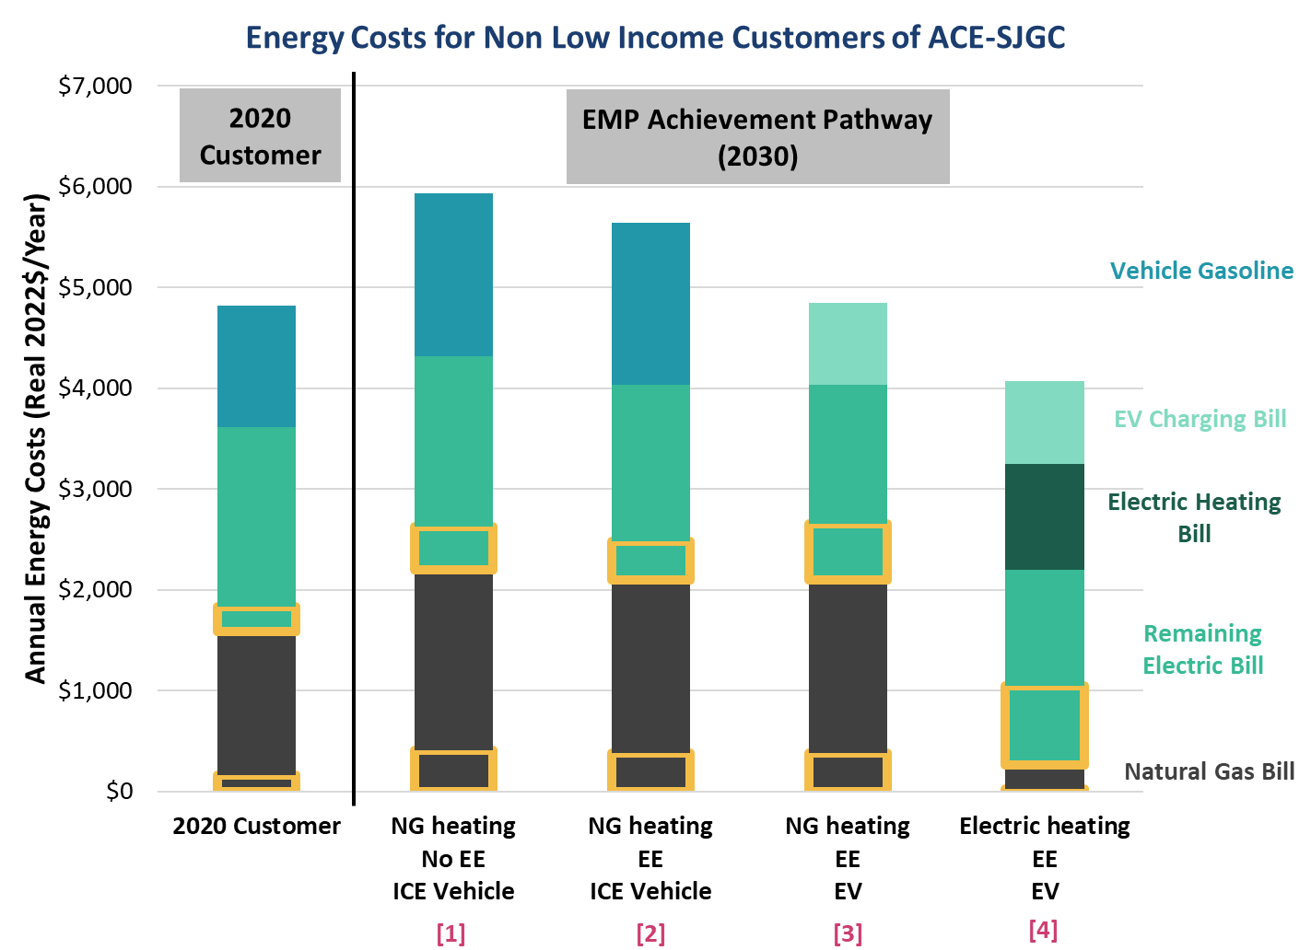
Takeaway 3: Total energy cost increases under the EMP Achievement Pathway are modest relative to the Current Policy Pathway
Total Energy Cost impacts are higher under the EMP Achievement Pathway, but only moderately relative to the Current Policy Pathway:
Customer [2] cost increases by 17% relative to the [2020 Customer] under the EMP. This is 6 percentage points higher than the impact under the Current Policy Pathway.
Customer [4] cost decreases by 16% relative to the [2020 Customer]. This is 1 percentage point lower than that achieved under the Current Policy Pathway.
Note: This scenario assumes NJ meets its EV goal of 330,000 in 2025. EV program expenses are modeled as higher under this scenario, but other state incentives and/or programs will also likely be necessary. Similarly, heating electrification incentive costs have not been separately reflected, as these programs have not yet been defined. In both cases, rate impacts of these initiatives are highly dependent on availability of Societal Benefits Charge funds, federal and state tax policy, and other factors.
Note: Annual energy costs are shown for non-low-income customers of ACE – SJG. Results have similar directionality for other utility combinations.
Yellow boxes represent the “clean energy program costs” within the bills.

Slide 28
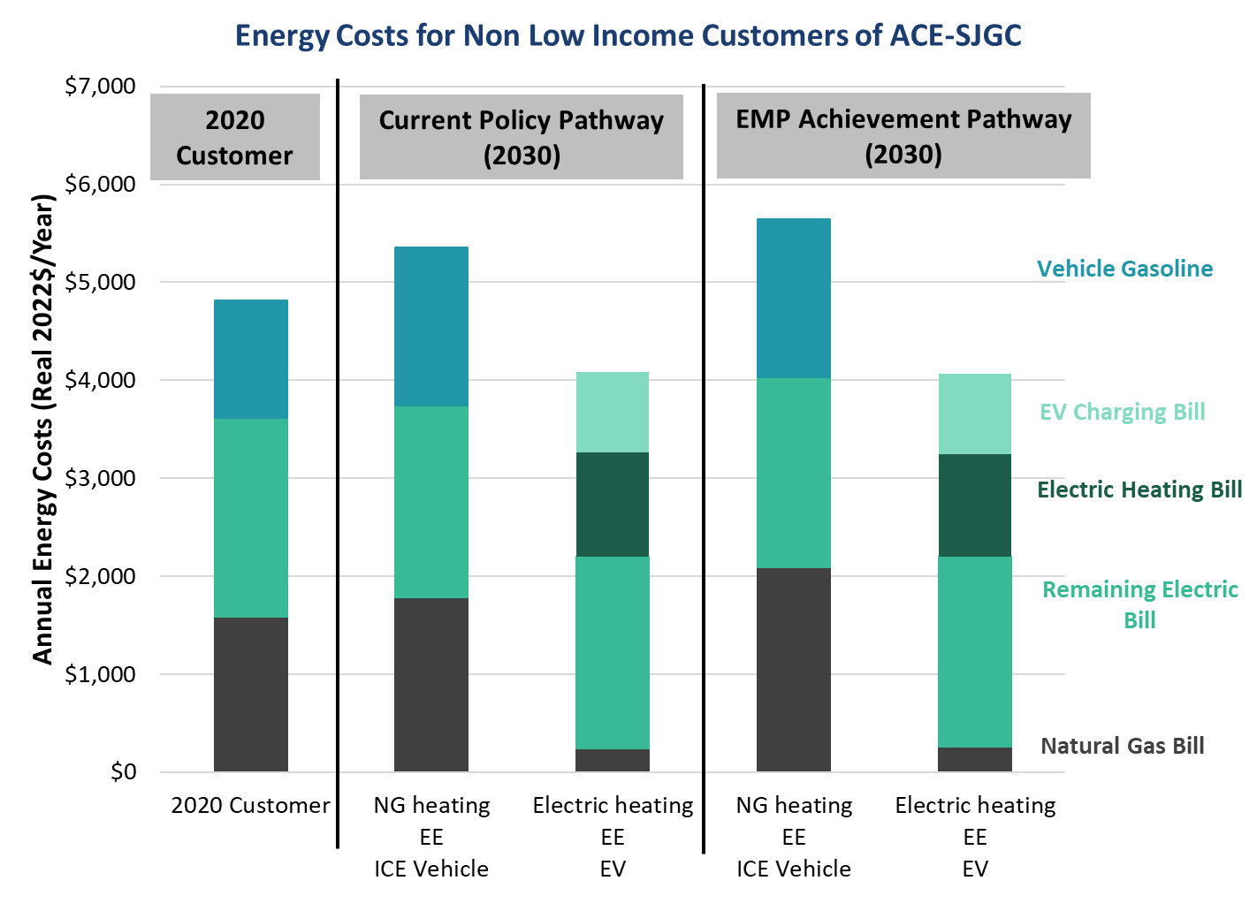
(Continued) Across all scenarios, customers with electrified end-uses experience savings
Across all scenarios, electrification of transportation and heating leads to cost savings, while using fossil fuels leads to cost increases.
[2] Customers who continue to use natural gas for heating and ICE vehicle experience cost increases of 11-17% compared to [2020 Customer]
[4] Customers who have electric vehicles and electric heating experience cost savings of 15-16% compared to [2020 Customer]
[2]
[4]
[2]
[4]

Slide 29
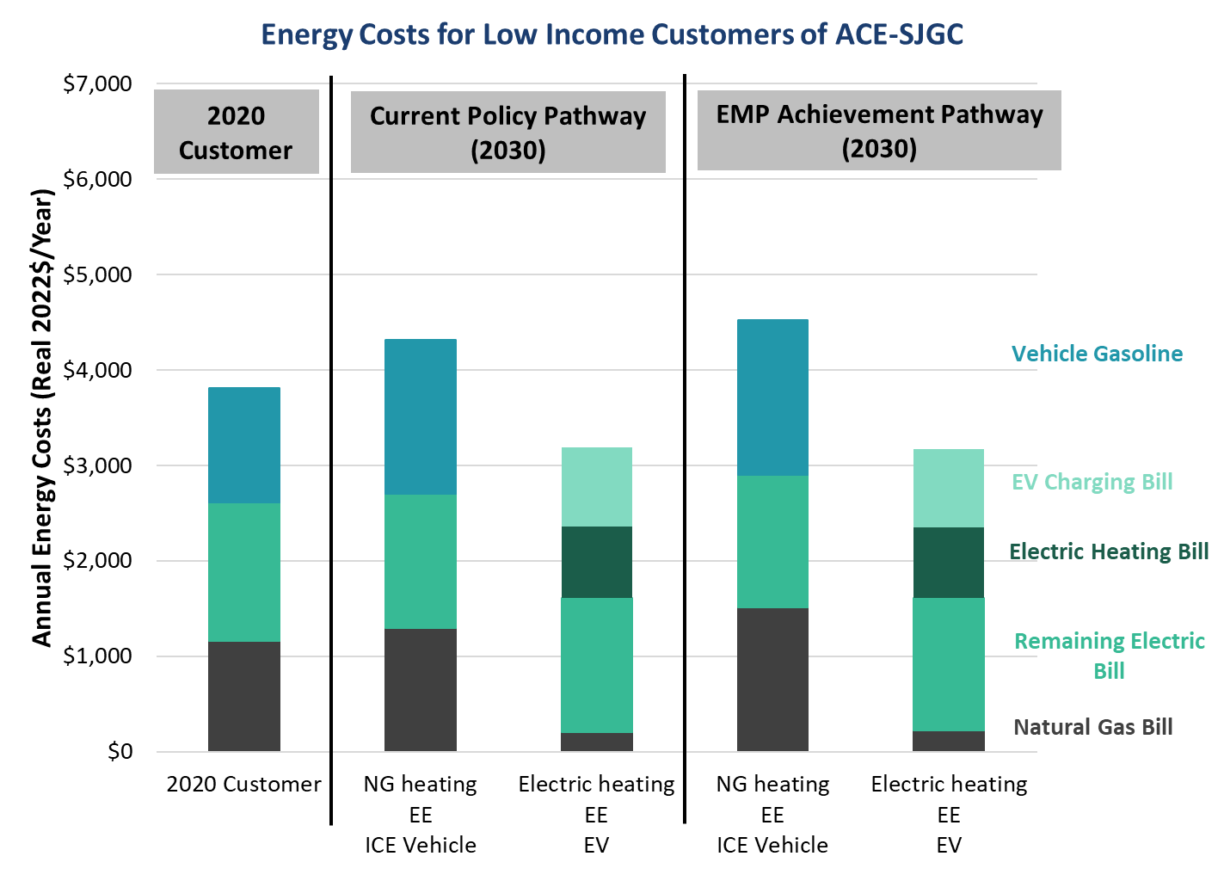
Takeaway 4: EE and electrification may help reduce energy burden for low- and moderate-income customers.
Low-income customers may need assistance for EE & electrification; otherwise, they may experience increased energy burden.
The direction of the results is the same for low-income customers. The only difference is that low-income customers consume less energy, which leads to lower costs.
[2] total energy cost is 13-18% higher compared to the [2020 Customer]
[4] total energy cost is 16-17% lower compared to the [2020 Customer]
Energy burden is 6-8% without and 9-13% with vehicle operating costs for an annual income of ~$35K.
Low-income customer is defined as household incomes less than 300% of federal poverty level (FPL).¹ FPL is approximately $27K for a four-person household.²
Low-income customers consume 12% less electricity and gas than the average³
Energy burden w/ and
w/o vehicle operating cost
[2]
[4]
[2]
[4]
¹ Based on True Poverty report by Legal Services of New Jersey, 2021.
² 2021 Poverty Guidelines | ASPE (hhs.gov)
³ Based on EIA’s Residential Energy Consumption Survey (RECS), which provides data on energy consumption based on income levels. The percentages above are based on the Northeast region, of which New Jersey is a part.
10.9%
7.5%
12.3%
7.7%
9.1%
6.7%
12.9%
8.3%
9.1%
6.7%

Slide 30
Discussion

Slide 31
Public Comments
All comments received during this meeting will be added to the official record on this docket.
We ask that all speakers keep comments relevant to the Ratepayer Impact Study as being presented.
We also ask that speakers be concise by presenting key points to allow time for all registered speakers.
If we have additional time in the meeting, speakers may be invited to provide more comment.
05/23/2022 www.nj.gov/bpu

Slide 32
Docket No. EO22030130
Written Comments
The Board will be accepting written comments on this matter until 5pm E.D.T. on June 3, 2022.
Please submit comments directly to the specific docket listed above via email: board.secretary@bpu.nj.gov.
While electronic comments are preferred, written comments may also be mailed to the Secretary of the Board, at the Board of Public Utilities, 44 South Clinton Avenue, 1st Floor, P.O. Box 350, Trenton, NJ 08625-0350.
05/23/2022 www.nj.gov/bpu

Slide 33
Thank You!
05/23/2022 www.nj.gov/bpu

